Slide 1
Junction Field Effect Transistors

Slide 2
Field effect transistors (FETs) are usually termed as unipolar transistors because these FETs operations are involved with single-carrier type.
The field effect transistors are categorized into different types such as a MOSFET, JFET, DGMOSFET, FREDFET, HIGFET, QFET, and so on.
junction field effect transistor is one type of FETs which is used as a switch that can be controlled electrically.
Through the active channel, electric energy will flow from between the source terminal and drain terminal.
If the gate terminal is supplied with reverse bias voltage, then the flow of current will be completely switched off and the channel gets strained.
The junction field effect transistor is generally classified into two types based on their polarities and they are:
N-Channel junction field effect transistor
P-Channel junction field effect transistor

Slide 3
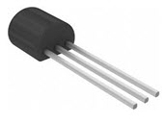
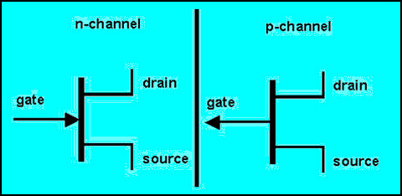
N-Channel Junction Field Effect Transistor
The JFET in which electrons are primarily composed as the charge carrier is termed as N-channel JFET. Hence, if the transistor is turned on, then we can say that the current flow is primarily because of the movement of electrons.

Slide 4
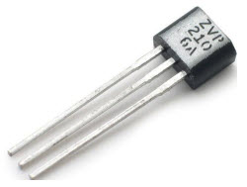
P-Channel Junction Field Effect Transistor
The JFET in which holes are primarily composed as the charge carrier is termed as P-channel JFET. Hence, if the transistor is turned on, then we can say that the current flow is primarily because of the holes.

Slide 5
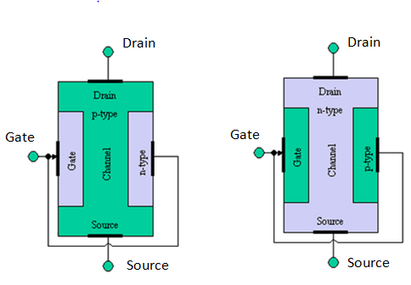
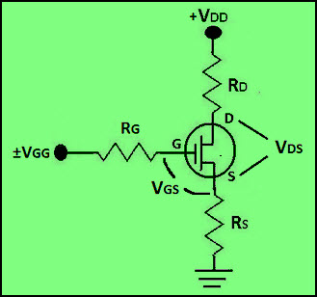
N-Channel Operation of JFET
For turning ON a N-channel JFET, positive voltage of VDD has to be applied to the drain terminal of the transistor w.r.t (with respect to) source terminal
such that the drain terminal must be appropriately more positive than the source terminal.
Thus, current flow is allowed through the drain to source channel.
If the voltage at the gate terminal, VGG is 0V, then there will be maximum current at the drain terminal and N-channel JFET is said to be in ON condition.

Slide 6
For turning off the N-channel JFET, the positive bias voltage can be turned off or a negative voltage can be applied to the gate terminal.
Thus, by changing the polarity of the gate voltage the drain current can be reduced and then N-channel JFET is said to be in OFF condition.

Slide 7
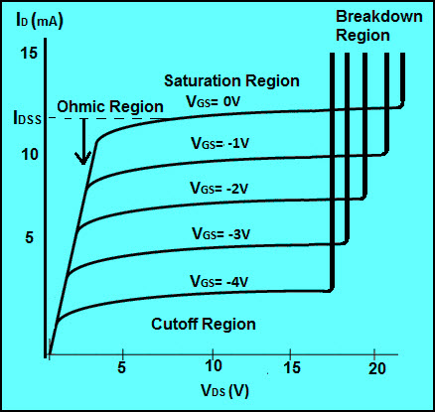
N-Channel JFET Characteristics
The N-channel JFET characteristics or transconductance curve is shown in the figure below
which is graphed between drain current and gate-source voltage.
There are multiple regions in the transconductance curve and they are ohmic, saturation, cutoff, and breakdown regions.

Slide 8
Ohmic Region The only region in which transconductance curve shows linear response and drain current is opposed by the JFET transistor resistance is termed as Ohmic region.
Saturation Region In the saturation region, the N-channel junction field effect transistor is in ON condition and active, as maximum current flows because of the gate-source voltage applied.
Cutoff Region In this cutoff region, there will be no drain current flowing and thus, the N-channel JFET is in OFF condition.
Breakdown Region If the VDD voltage applied to the drain terminal exceeds the maximum necessary voltage, then the transistor fails to resist the current and thus, the current flows from drain terminal to source terminal. Hence, the transistor enters into the breakdown region.

Slide 9
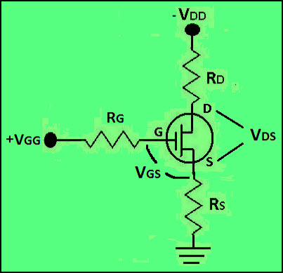
P-Channel Operation of JFET
For turning ON P-channel JFET, negative voltage can be applied across the drain terminal of the transistor w.r.t source terminal
such that the drain terminal must be appropriately more negative than the source terminal.
Thus, the current flow is allowed through the drain to source channel.
If the voltage at the gate terminal, VGG is 0V, then there will be maximum current at the drain terminal and the P-channel JFET is said to be in ON condition.

Slide 10
For turning OFF the P-channel JFET, the negative bias voltage can be turned off or positive voltage can be applied to the gate terminal.
If the gate terminal is given positive voltage, then the drain currents starts reducing (until cutoff) and thus the P-channel JFET is said to be in OFF condition.

Slide 11
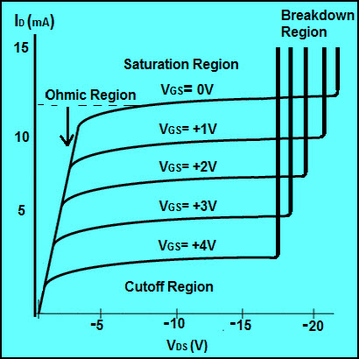
P-Channel JFET Characteristics
The P-channel JFET characteristics or transconductance curve is shown in the figure below
which is graphed between drain current and gate-source voltage.
There are multiple regions in the transconductance curve and they are ohmic, saturation, cutoff, and breakdown regions.

Slide 12
Ohmic Region The only region in which transconductance curve shows linear response and drain current is opposed by the JFET transistor resistance is termed as Ohmic region.
Saturation Region In the saturation region, the P-channel junction field effect transistor is in ON condition and active, as maximum current flows because of the gate-source voltage applied.
Cutoff Region In this cutoff region, there will be no drain current flowing and thus, the P-channel JFET is in OFF condition.
Breakdown Region If the VDD voltage applied to the drain terminal exceeds the maximum necessary voltage, then the transistor fails to resist the current and thus, the current will flow from drain terminal to source terminal. Hence, the transistor enters into the breakdown region.

